Slide 1
Module 4 Session 1
Webinar 2022

Slide 2
Understanding autism
Learning from autistic people (inside-out v outside-in).
Quality of life and wellbeing.
Maslow’s hierarchy of needs:
As a framework for supporting autistic children and young people.
Environmental impact.

Slide 3



Learning from autistic people
Neurodiversity – what we've learned to date.
Language – person first v identity.
Functioning debate.

Slide 4
Quality of life and wellbeing
International Classification of Functioning, Disability and Health, ICF-CY:
In take away notes;
Also looked at in Session 6.
Look at the whole day – A Day in the Life in Session 3.
Physical, mental, sensory and social wellbeing.
Physiological needs – being safe and feeling safe.
General safety across all domains.

Slide 5

Quality of life and wellbeing
Quality of life is of critical importance for autistic people:
as many struggle with living in a non-autistic world.
Researchers have suggested that:
physical wellbeing is a key factor underpinning quality of life;
actions aimed at ensuring a healthy state should be a priority.
Important to note for:
autistic people and agencies supporting them.

Slide 6
Quality of life
Children with additional needs report:
lower levels of quality of life and wellbeing than children without additional needs.
Autistic people can tell non-autistic people what supports their wellbeing and quality of life.
This reflects the emphasis Circular 030/14 places on listening to the view of the child.

Slide 7
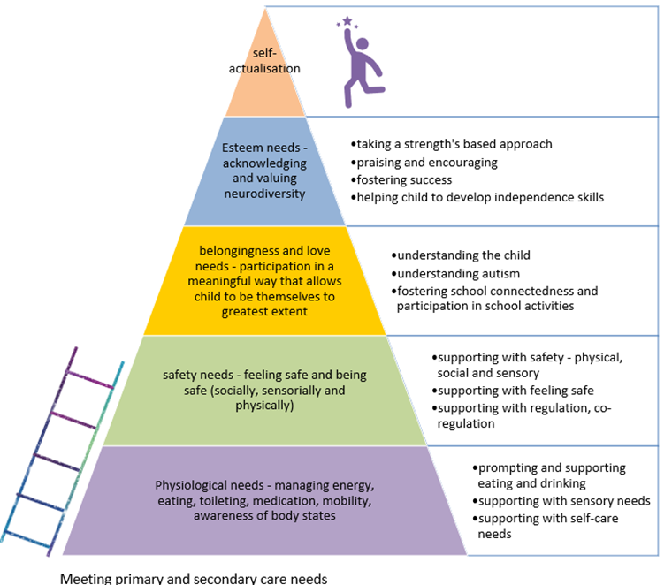
Maslow’s hierarchy

Slide 8
Environmental Impact
Golden equation - Dr Luke Beardon.
Multi-faceted:
Physical, sensory, social, communicative, internal
Autism
Environment
Outcome

Slide 9
Ultimately
Strength's focused always.
Child/young person's voice and autonomy central at all times.
Hear – Honour - Validate

